Slide 1





E-Commerce AI Architecture Concept Map
Recommendations
Product Copies
Fraud Detection
Chatbot Support
Suggests products by finding hidden correlations in user clickstreams & buying patterns.
Reviews real-time transaction attributes to instantly calculate risk flags.
Generates marketing titles, feature sheets, and advertising copies instantly.
Interacts with shoppers, solves support tickets, and clarifies shipping policies.
JUSTIFICATION
JUSTIFICATION
Applies classification trees & isolation forests that detect statistical anomalies in live streams.
JUSTIFICATION
Utilizes massive Transformer architectures specialized in deep contextual natural dialog.
JUSTIFICATION
Uses statistical Collaborative Filtering to output recommendations without hardcoded logic.
Focuses entirely on synthesizing brand new text assets based on structural input specs.

Slide 2
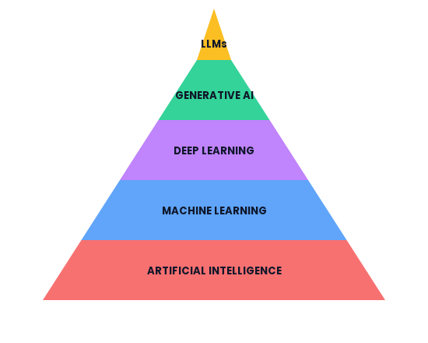




The 5-Layer AI Pyramid Model
Language Champions
Specialized text synthesis & reasoning engines (e.g. GPT-4, Llama).
Content Creators
Creates novel structures (images, music, text, synthetic codes).
Neural Network Mimics
Multi-layered grids processing unstructured data (images, audio streams).
Pattern Extractors
Learns direct rules & predictors dynamically from static training charts.

